Slide 1
WEB AUTHORING
SESSION 01 – INTRODUCTION TO HTML

Slide 2
Objective
Introduction to Internet and WWW
Introduction to HTML
Using Hyperlink in HTML documents
Path
Types of Hyperlink

Slide 3
Internet and WWW
The Internet can powerfully leverage your ability to find, manage, and share information
The Internet is referred to as a network of networks
One of the subsets of Internet is the World Wide Web
WWW contains a number of web servers scattered across the world

Slide 4
Introduction to HTML
HTML is a language for describing web pages.
HTML stands for Hyper Text Markup Language
HTML is not a programming language, it is a markup language
A markup language is a set of markup tags
HTML uses markup tags to describe web pages

Slide 5
Introduction to HTML
Using HTML tags and elements, we can:
Control the appearance of the page and the content
Publish online documents and retrieve online information using the links inserted in the HTML document
Create on-line forms. These forms can be used to collect information about the user, conduct transactions, and so on

Slide 6
The First Example
<html>
<head>
<title>Hello HTML</title>
</head>
<body>
<p>Hello World!</p>
</body>
</html>

Slide 7
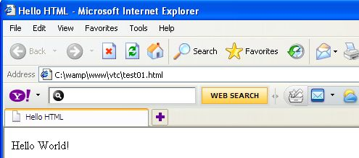
Output

Slide 8
Browsers and Editors
Browsers
Netscape's Navigator
Microsoft's Internet Explorer
Mozilla Firefox
Editors
Notepad
Microsoft FrontPage
Macromedia Dreamweaver

Slide 9
HTML tags
<html>...</html>: The Root element of an HTML document. The HTML element delimits the beginning and the end of an HTML document.
<head>...</head>: Container for processing information and metadata for an HTML document.
<body>...</body>: Container for the displayable content of an HTML document.

Slide 10
HTML Element Syntax
An HTML element starts with a start tag / opening tag
An HTML element ends with an end tag / closing tag
The element content is everything between the start and the end tag
Some HTML elements have empty content
Empty elements are closed in the start tag
Most HTML elements can have attributes

Slide 11
Tag Syntax
<tag attribute1="value1" attribute2="value2">content to be rendered</tag>
tag - identifies the tag
attribute - describes the tag
value - the content that is assigned to the attribute
Sample: paragraph element
<p>Paragraph 1</p>
<p align=“center”>Paragraph 2</p>

Slide 12
Paragraph
<HTML>
<HEAD>
<TITLE>Welcome to HTML</TITLE>
</HEAD>
<BODY BGCOLOR = green>
<p>This is my first paragraph.</p>
<p> Another paragraph element</p>
</BODY>
</HTML>

Slide 13
Align attribute
Value | Description
Left | The text is displayed on the left
Center | The text is centered within both the margins
Right | The text is displayed on the right
Justify | The text is justified along both the margins

Slide 14
Empty HTML Elements
HTML elements with no content are called empty elements. Empty elements can be closed in the start tag.
<br> is an empty element without a closing tag (the <br> tag defines a line break).
In XHTML, XML, and future versions of HTML, all elements must be closed.
Adding a slash to the start tag, like <br />, is the proper way of closing empty elements, accepted by HTML, XHTML and XML.
Even if <br> works in all browsers, writing <br /> instead is more future proof.

Slide 15
Introduction to links and anchors
A hyperlink is a word, group of words, or image that you can click on to jump to a new document or a new section within the current document.
When you move the cursor over a link in a Web page, the arrow will turn into a little hand.
Links are specified in HTML using the <a> tag.
The <a> tag can be used in two ways:
To create a link to another document, by using the href attribute
To create a bookmark inside a document, by using the name attribute

Slide 16
Syntax
The syntax of hyperlink is :
<A HREF =“protocol://host.domain:port/path”> Hypertext </A>
Protocol is the protocol type
Host.domain is the Internet address of the server
Port is the port number of the destination server
Hypertext is the text or images that the user must click to activate the link

Slide 17
Sample
<a href="http://www.msn.com/">Visit MSN</a>
<a name="tips">Useful Tips Section</a>
Create a link to the "Useful Tips Section" inside the same document:
<a href="#tips">Visit the Useful Tips Section</a>
Email link:
<a href=mailto:test@gmail.com> mail to admin</a>

Slide 18
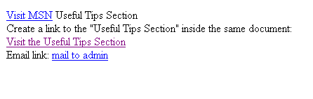
Output

Slide 19
Targets
You can specify a target window or frame for a hyperlink
<a href="page1.html" target="_self">Go To Page 1</a>
The target window options are: _self : Opens in the same window and same frame. _top : Opens in the same window, taking the full window if there is more than one frame. _parent : Opens in the parent frame. _blank : Opens in a new window.

Slide 20
Summary
In this session, we learnt:
The Internet can powerfully leverage your ability to find, manage, and share information
The World Wide Web is a system of interlinked hypertext documents accessed via the Internet
HTML documents are structured into two parts, the HEAD, and the BODY
A link is a connection from one Web resource to another
The target window options are:
_self : Opens in the same window and same frame.
_top : Opens in the same window, taking the full window if there is more than one frame.
_parent : Opens in the parent frame.
_blank : Opens in a new window.

